Slide 1
Safe&Go
Sihan Wang
Xinuan Xing
Loris de Lamper
Beau Delfosse
Group 39
15th March 2022

Slide 2
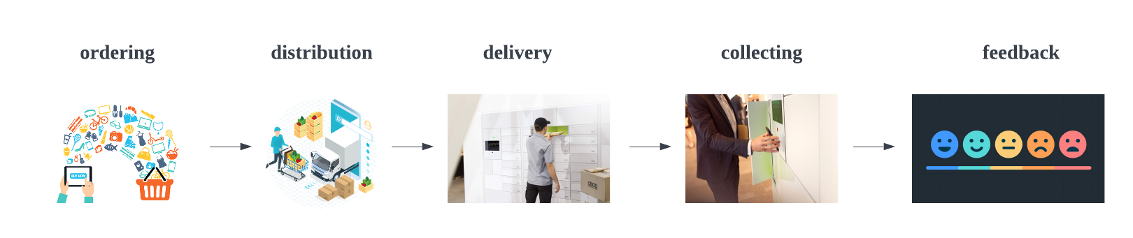
Concept
Easy procedure
Safety and hygiene
Quick collection
24/7 availability
Multiple location

Slide 3

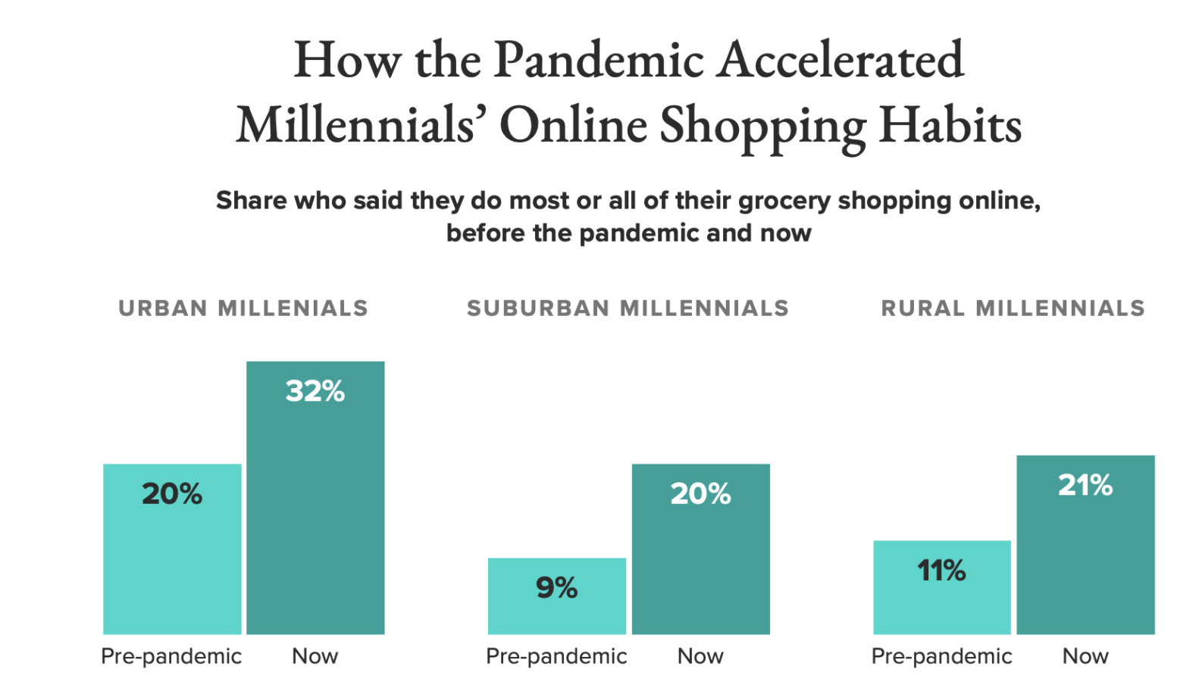
Customer Concern Highlights
Freshness and Food Quality
On-time delivery
Environmentally Friendly Packaging
Limiting Social Interaction
Off-hour Shopping

Slide 4
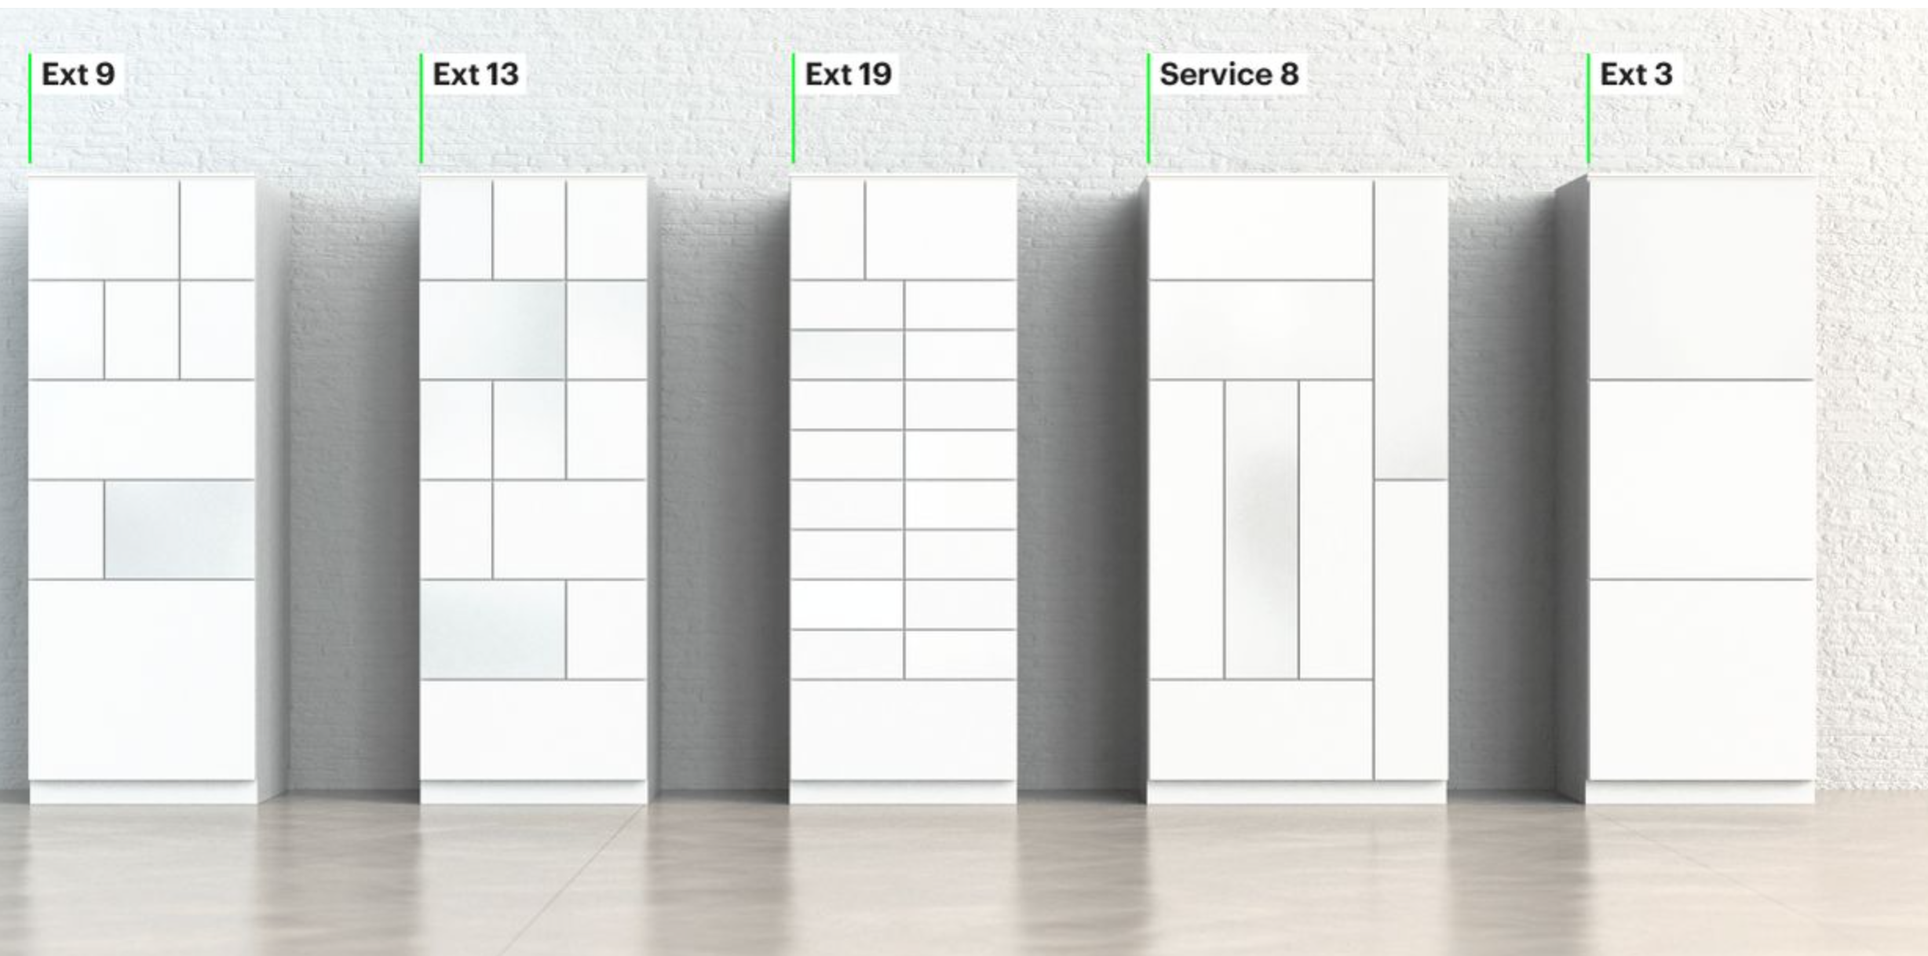
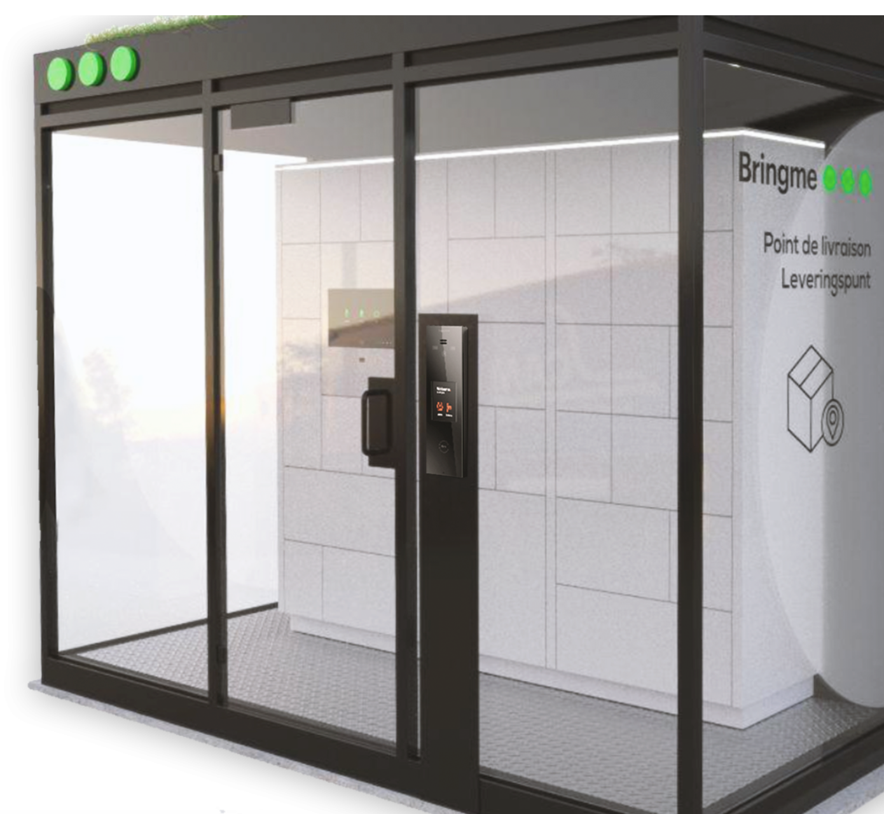
Partnership - BringMe
De bringme Box: smart parcel locker
App integration
Option: Acquiring own safe lockers
80% of the material is of circular origin

Slide 5



Sustainability
Reusable packaging
Waste reduction
Minimal packaging
Lower develoption
Shorter distance
Service cost reduction
Colruyt spin-off integration
Time reduction
Longer order storage time
Multiple collection location

Slide 6
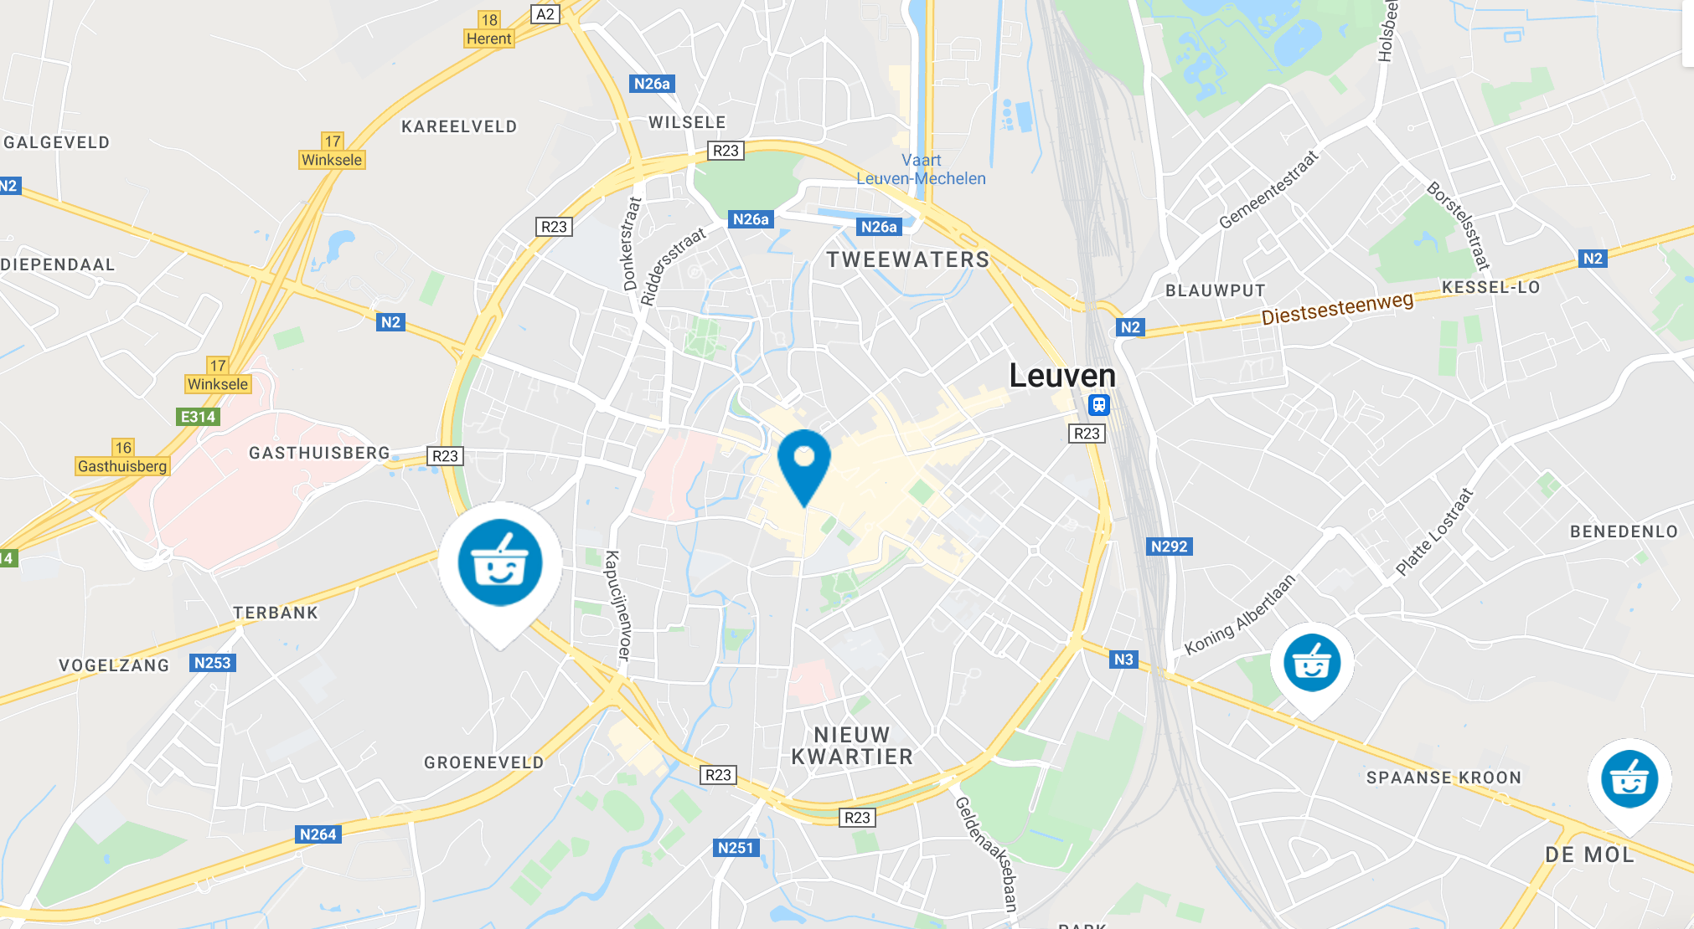
Financial advantages
Expansion cost < Collect&Go stores
Use of existing smart parcel lockers
Less employees needed
Digitalization
Low scale test phase
Leasing start

Slide 7
Time for Q&A
Thank you for your attention

